Slide 1

Get Started
Wenxuan Shi
College of Software, Nankai University
Email: shiwx@nankai.edu.cn
Wechat: 13920561100

Slide 2

What is Flutter?
Flutter is Google’s UI toolkit for building beautiful, natively compiled applications for mobile, web, and desktop from a single codebase.
Notes:
Brand-driven == customized
Internal teams at Google (CRM system) have managed to build functioning prototypes in a week.
Designers with 0 coding experiences became productive with Flutter in weeks - allowing them to build prototypes in hours.

Slide 3
Where to Start?
Website: https://flutter.dev/
Community: https://flutter.dev/community
Docs: https://flutter.dev/docs
Github: https://github.com/flutter
Showcase: https://flutter.dev/showcase
Codelabs: https://codelabs.developers.google.com/?cat=Flutter
Using Flutter in China: https://flutter.dev/community/china

Slide 4

Who's using Flutter?

Slide 5
Features
Notes:
StatelessWidget is used for immutable elements that only rely on the object configuration information
StatefulWidget is used for elements that can dynamically change based on state-changes in the system
Everytime that state changes, setChange() is called by the object

Slide 6
Fast Development
Paint your app to life in milliseconds with Stateful Hot Reload.
Use a rich set of fully-customizable widgets to build native interfaces in minutes.

Slide 7
Expressive and Flexible UI
Quickly ship features with a focus on native end-user experiences.
Layered architecture allows for full customization, which results in incredibly fast rendering and expressive and flexible designs.

Slide 8
Native Performance
Flutter’s widgets incorporate all critical platform differences such as scrolling, navigation, icons and fonts, and your Flutter code is compiled to native ARM machine code using Dart's native compilers.
Thus Flutter gives you full native performance on both iOS and Android.

Slide 9
Install & Test
Notes:
I’d like to concentrate on two parts of Flutter, that I especially admire

Slide 10
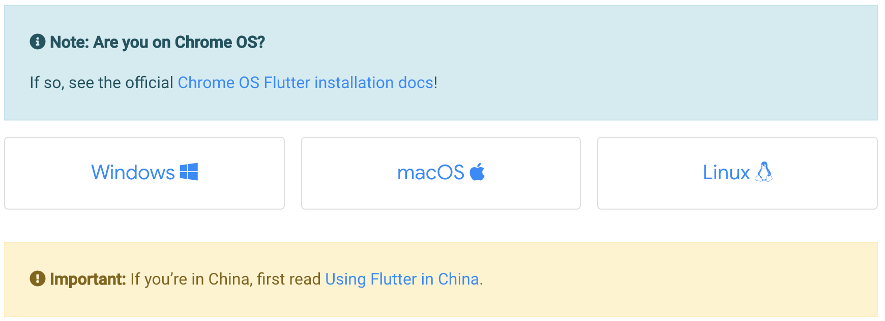
Install
Select the operating system on which you are installing Flutter:
Notes:
The beauty of hot reload is, that even after fixing an error, state is still maintained - allowing to iterate and develop far quicker.

Slide 11
Test drive
Select your development tool of choice for writing, building, and running Flutter apps.
Android Studio and IntelliJ
Visual Studio Code
Terminal & editor
Notes:
The beauty of hot reload is, that even after fixing an error, state is still maintained - allowing to iterate and develop far quicker.

Slide 12
Create the app
Open the IDE and select Start a new Flutter project.
Select Flutter Application as the project type. Then click Next.
Verify the Flutter SDK path specifies the SDK’s location (select Install SDK… if the text field is blank).
Enter a project name (for example, myapp). Then click Next.
Click Finish.
Wait for Android Studio to install the SDK and create the project.
Notes:
Also available via IntelliJ’s built-in debugger

Slide 13
Run the app
Locate the main Android Studio toolbar:
In the target selector, select an Android device for running the app. If none are listed as available, select Tools> Android > AVD Manager and create one there.
Click the run icon in the toolbar, or invoke the menu item Run > Run.
Notes:
Also available via IntelliJ’s built-in debugger

Slide 14
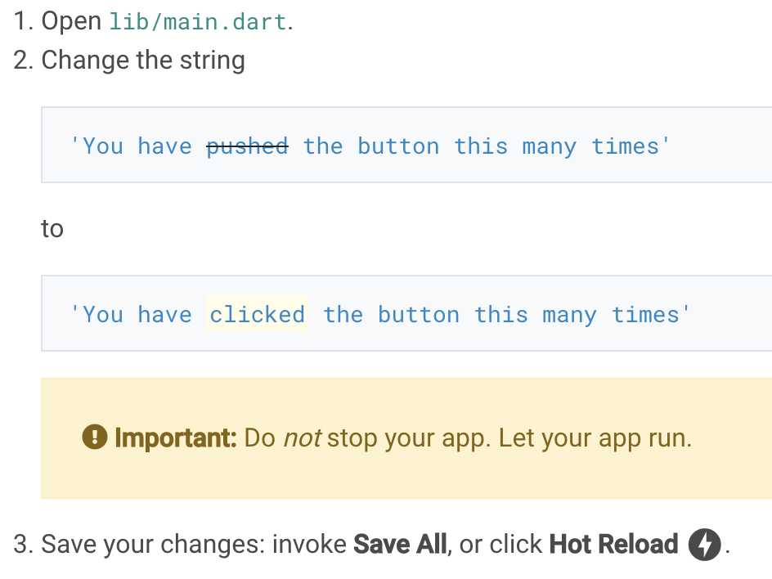
Try hot reload
Flutter offers a fast development cycle with Stateful Hot Reload, the ability to reload the code of a live running app without restarting or losing app state.
Notes:
Also available via IntelliJ’s built-in debugger

Slide 15
Write your first Flutter app Part 1
Notes:
I’d like to concentrate on two parts of Flutter, that I especially admire

Slide 16
What you’ll learn?
How to write a Flutter app that looks natural on iOS, Android, and the web.
Basic structure of a Flutter app.
Finding and using packages to extend functionality.
Using hot reload for a quicker development cycle.
How to implement a stateful widget.
How to create an infinite, lazily loaded list.
Notes:
The beauty of hot reload is, that even after fixing an error, state is still maintained - allowing to iterate and develop far quicker.

Slide 17
What you'll use?
You can run this codelab using any of the following devices:
A physical device (Android or iOS) connected to your computer and set to developer mode
The iOS simulator
The Android emulator
A browser (Chrome is required for debugging)
Notes:
The beauty of hot reload is, that even after fixing an error, state is still maintained - allowing to iterate and develop far quicker.

Slide 18
Step 1: Create the starter Flutter app
Create a simple, templated Flutter app, using the instructions in Getting Started with your first Flutter app.
Name the project startup_namer
In this codelab, you’ll mostly be editing lib/main.dart, where the Dart code lives.

Slide 19
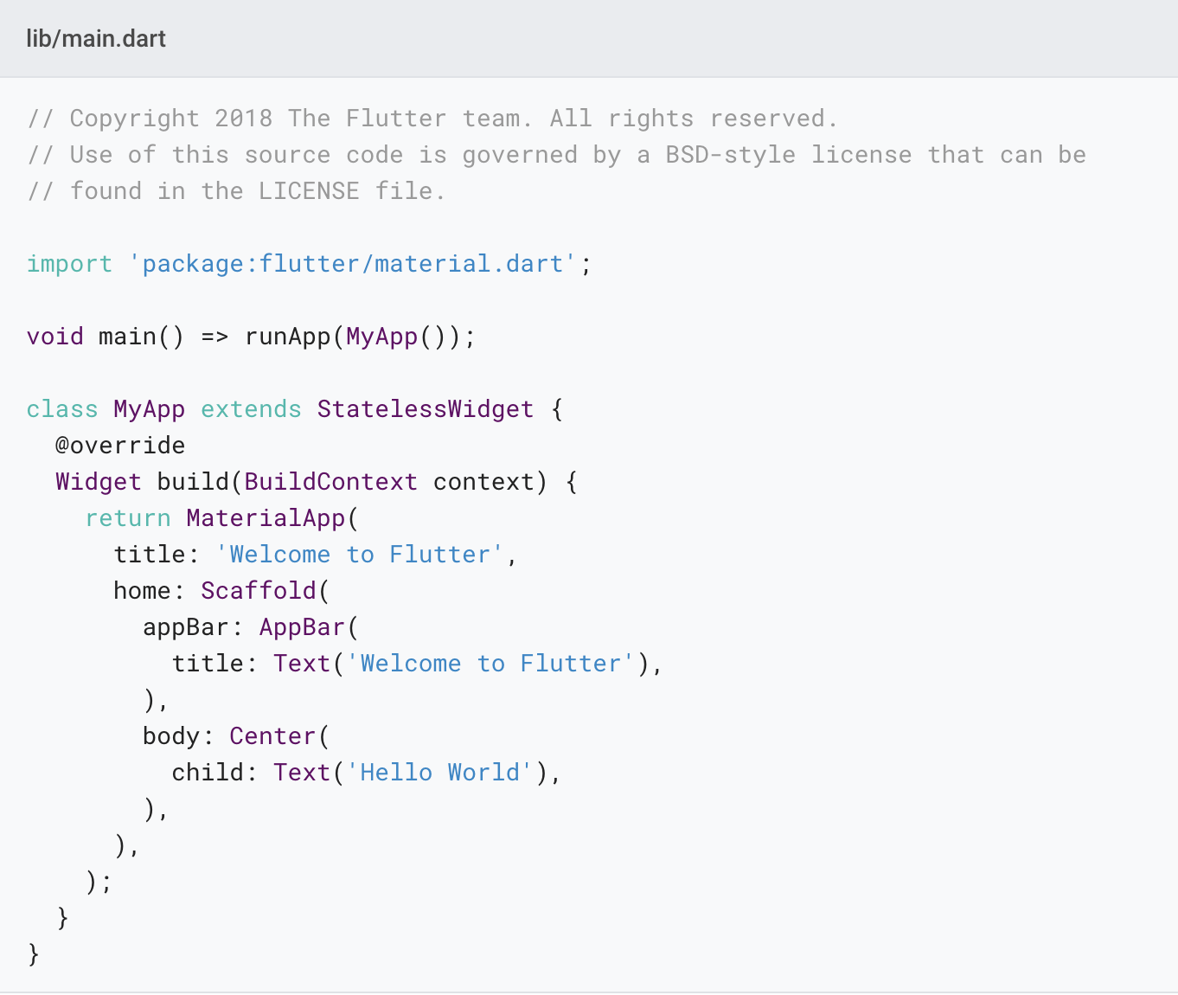
Replace the contents of lib/main.dart.
Delete all of the code from lib/main.dart. Replace with the following code, which displays “Hello World” in the center of the screen.

Slide 20
Run the app in the way your IDE describes. You should see either Android, iOS, or web output, depending on your device.

Slide 21
Observations
This example creates a Material app. Material is a visual design language that is standard on mobile and the web. Flutter offers a rich set of Material widgets.
The main() method uses arrow (=>) notation. Use arrow notation for one-line functions or methods.
The app extends StatelessWidget which makes the app itself a widget. In Flutter, almost everything is a widget, including alignment, padding, and layout.

Slide 22
Observations
The Scaffold widget, from the Material library, provides a default app bar, title, and a body property that holds the widget tree for the home screen. The widget subtree can be quite complex.
A widget’s main job is to provide a build() method that describes how to display the widget in terms of other, lower level widgets.
The body for this example consists of a Center widget containing a Text child widget. The Center widget aligns its widget subtree to the center of the screen.

Slide 23
Step 2: Use an external package
In this step, you’ll start using an open-source package named english_words, which contains a few thousand of the most used English words plus some utility functions.
You can find the english_words package, as well as many other open source packages, on pub.dev.

Slide 24
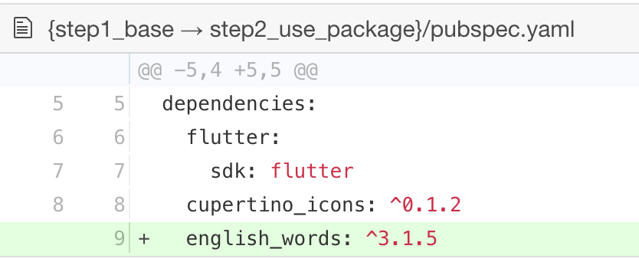
The pubspec.yaml file manages the assets and dependencies for a Flutter app. In pubspec.yaml, add english_words (3.1.5 or higher) to the dependencies list:

Slide 25
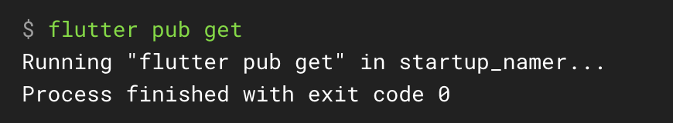
While viewing the pubspec.yaml file in Android Studio’s editor view, click Pub get. This pulls the package into your project. You should see the following in the console:

Slide 26
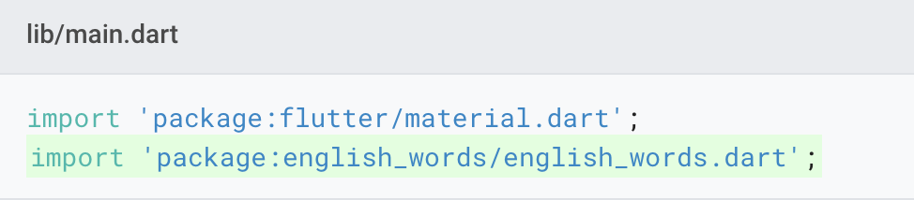
In lib/main.dart, import the new package:

Slide 27
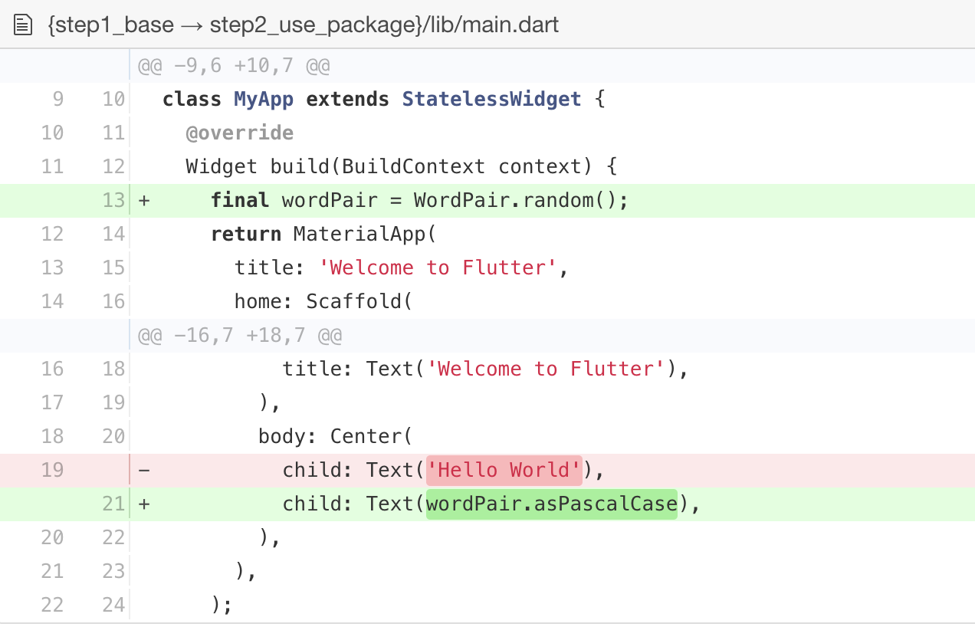
Use the English words package to generate the text instead of using the string “Hello World”:

Slide 28
If the app is running, hot reload to update the running app. Each time you click hot reload, or save the project, you should see a different word pair, chosen at random, in the running app.

Slide 29
Problems?
If your app is not running correctly, look for typos. If you want to try some of Flutter’s debugging tools, check out the DevTools suite of debugging and profiling tools. If needed, use the code at the following links to get back on track.
pubspec.yaml
lib/main.dart

Slide 30
Step 3: Add a Stateful widget
Stateless widgets are immutable, meaning that their properties can’t change—all values are final.
Stateful widgets maintain state that might change during the lifetime of the widget.
In this step, you’ll add a stateful widget, RandomWords, which creates its State class, RandomWordsState. You’ll then use RandomWords as a child inside the existing MyApp stateless widget.

Slide 31
Implementing a stateful widget requires at least two classes:
a StatefulWidget class that creates an instance of
a State class.
The StatefulWidget class is, itself, immutable, but the State class persists over the lifetime of the widget.

Slide 32
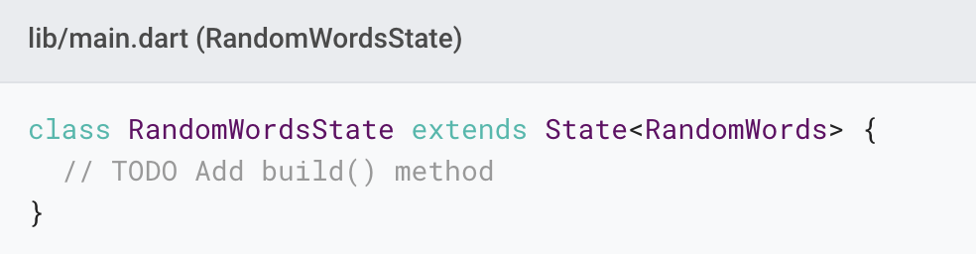
Create a minimal state class. Add the following to the bottom of main.dart:

Slide 33
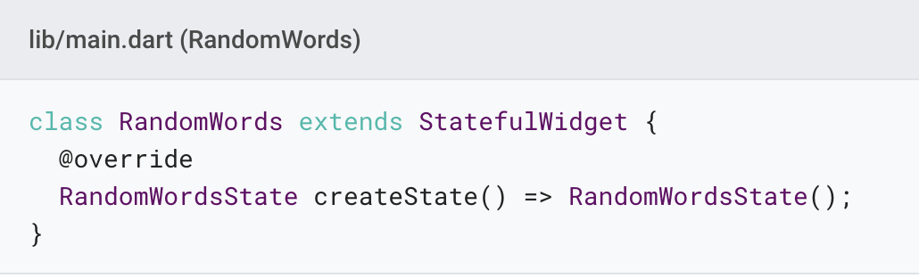
Add the stateful RandomWords widget to main.dart. The RandomWords widget does little else beside creating its State class:

Slide 34
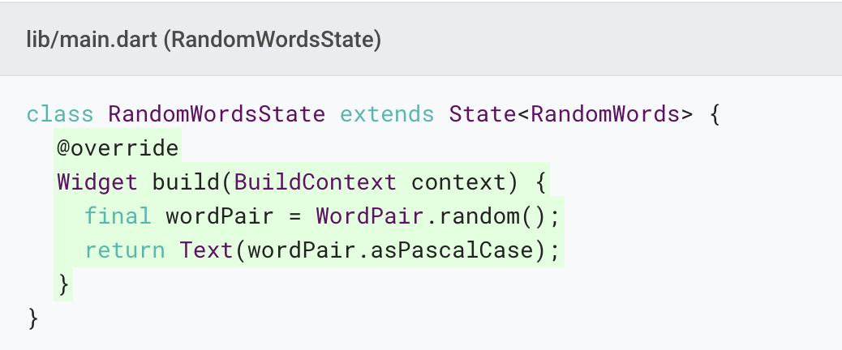
Add the build() method to RandomWordsState:

Slide 35
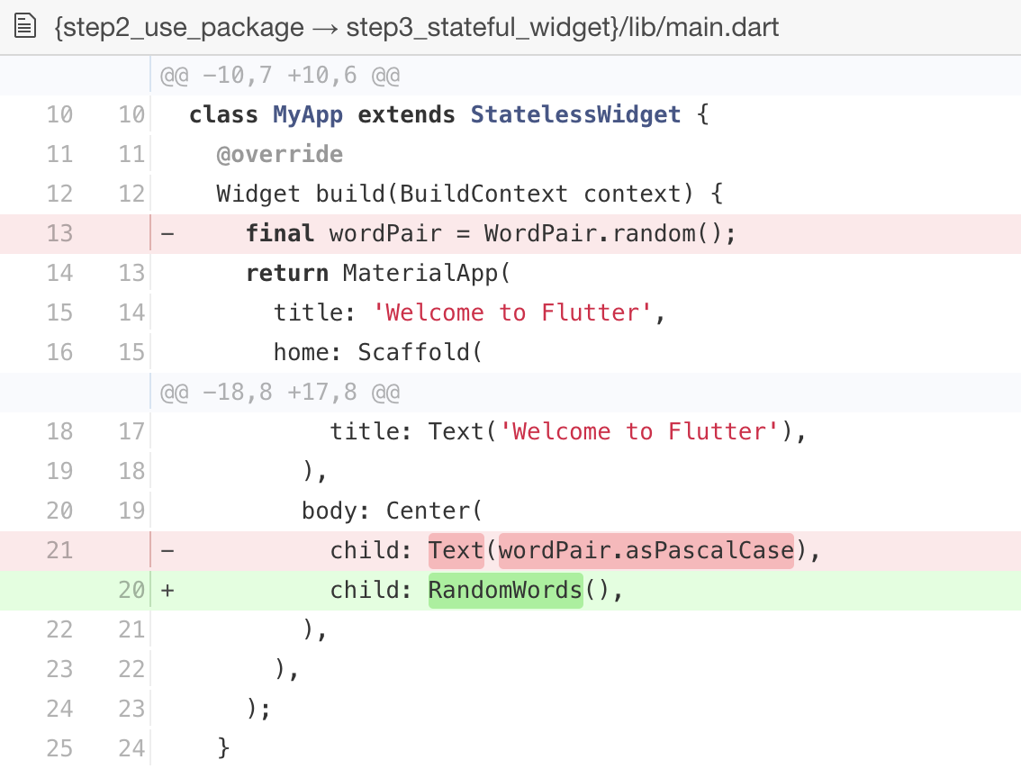
Remove the word generation code from MyApp by making the changes shown in the following diff:

Slide 36
Restart the app. The app should behave as before, displaying a word pairing each time you hot reload or save the app.

Slide 37
Problems?
If your app is not running correctly, look for typos. If you want to try some of Flutter’s debugging tools, check out the DevTools suite of debugging and profiling tools. If needed, use the code at the following link to get back on track.
lib/main.dart

Slide 38
Step 4: Create an infinite scrolling ListView
In this step, you’ll expand RandomWordsState to generate and display a list of word pairings.
As the user scrolls, the list displayed in a ListView widget, grows infinitely.
ListView’s builder factory constructor allows you to build a list view lazily, on demand.

Slide 39
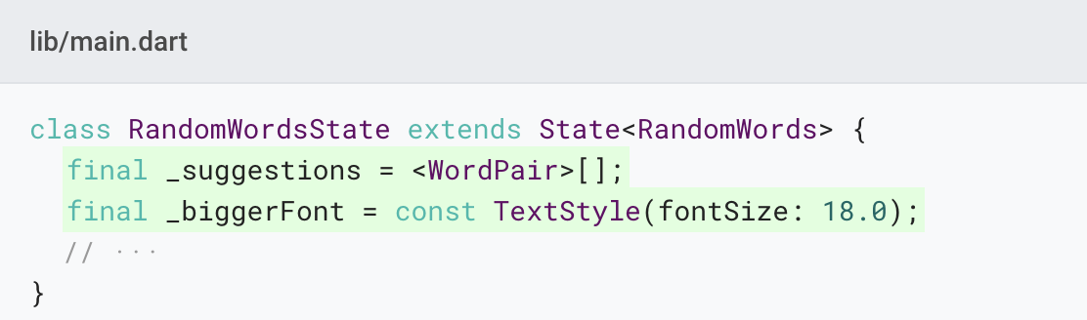
Add a _suggestions list to the RandomWordsState class for saving suggested word pairings. Also, add a _biggerFont variable for making the font size larger.

Slide 40
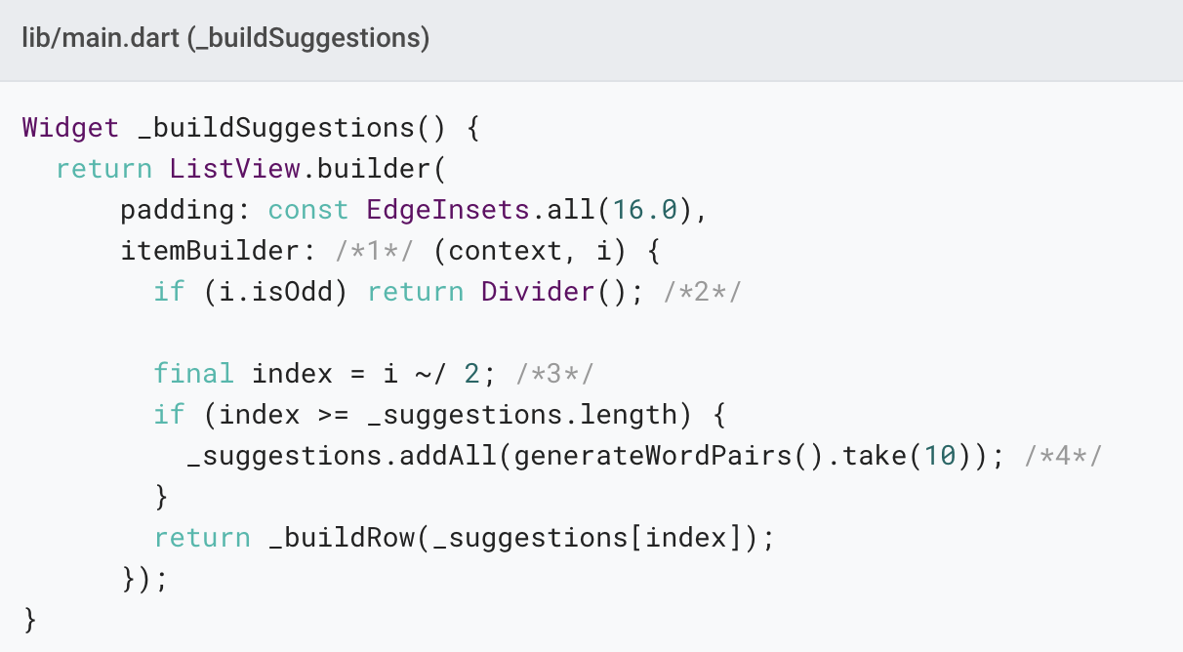
Add a _buildSuggestions() function to the RandomWordsState class:

Slide 41
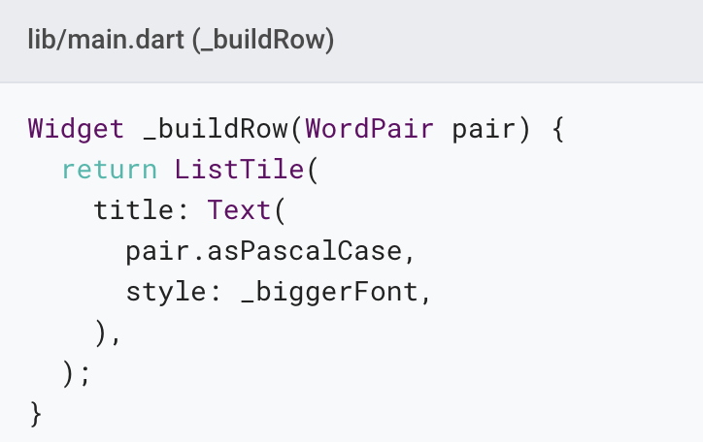
Add a _buildRow() function to RandomWordsState:

Slide 42
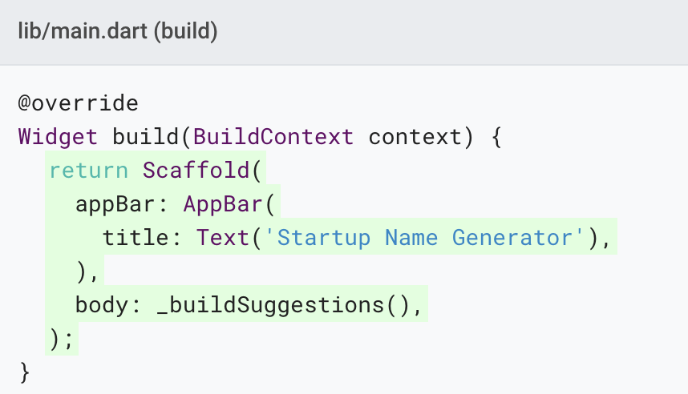
In the RandomWordsState class, update the build() method to use _buildSuggestions(), rather than directly calling the word generation library. (Scaffold implements the basic Material Design visual layout.) Replace the method body with the highlighted code:

Slide 43
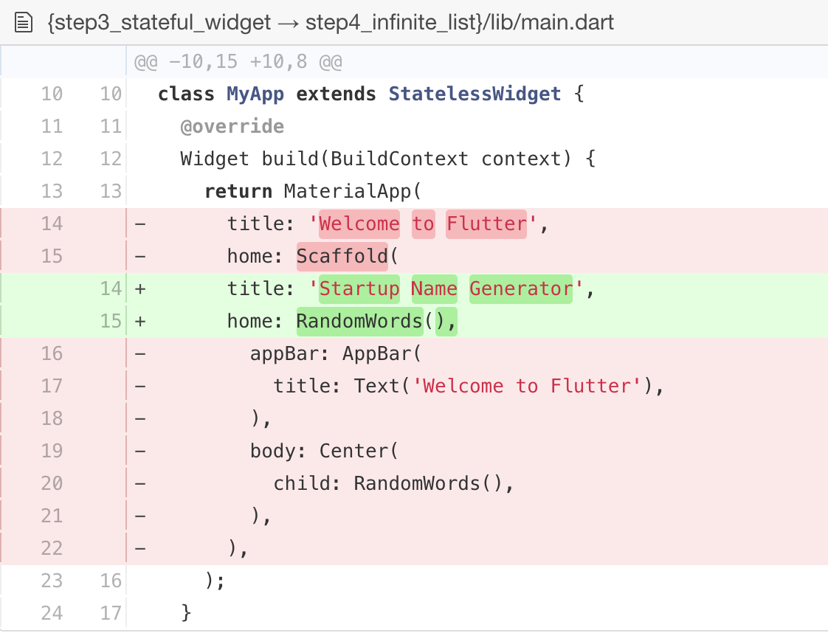
In the MyApp class, update the build() method by changing the title, and changing the home to be a RandomWords widget:

Slide 44
Restart the app. You should see a list of word pairings no matter how far you scroll.

Slide 45
Problems?
If your app is not running correctly, look for typos. If you want to try some of Flutter’s debugging tools, check out the DevTools suite of debugging and profiling tools. If needed, use the code at the following link to get back on track.
lib/main.dart

Slide 46
Profile or release runs
So far you’ve been running your app in debug mode. Debug mode trades performance for useful developer features such as hot reload and step debugging.
Once you are ready to analyze performance or release your app, you’ll want to use Flutter’s “profile” or “release” build modes.

Slide 47
Next steps
Congratulations! You’ve written an interactive Flutter app that runs on both iOS and Android. In this codelab, you’ve:
Created a Flutter app from the ground up.
Written Dart code.
Leveraged an external, third-party library.
Used hot reload for a faster development cycle.
Implemented a stateful widget.
Created a lazily loaded, infinite scrolling list.

Slide 48
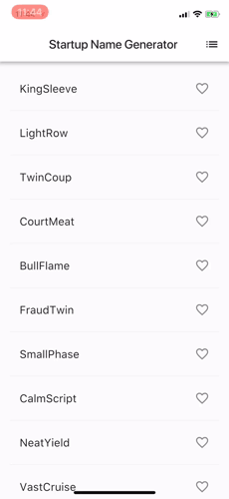
If you would like to extend this app, proceed to part 2 on the Google Developers Codelabs site, where you add the following functionality:
Implement interactivity by adding a clickable heart icon to save favorite pairings.
Implement navigation to a new route by adding a new screen containing the saved favorites.
Modify the theme color, making an all-white app.

Slide 49
Learn More
Notes:
I’d like to concentrate on two parts of Flutter, that I especially admire

Slide 50
Flutter basics
Introduction to widgets
Building layouts tutorial
Add interactivity tutorial

Slide 51
Apply your existing knowledge
Flutter for Android developers
From Java to Dart codelab
Flutter for iOS developers
Flutter for React Native developers
Flutter for web developers
Flutter for Xamarin.Forms developers

Slide 52
Other resources
Flutter samples
Flutter cookbook
Bootstrap into Dart: learn more about the language
Flutter API Docs
The Complete Flutter Developer Bootcamp Using Dart
Udacity online Flutter training

Slide 53
Write your first Flutter app Part 2
Notes:
I’d like to concentrate on two parts of Flutter, that I especially admire

Slide 54
Introduction
In this codelab, you'll extend a basic Flutter mobile app to include interactivity.
You'll also create a second page (called a route) that the user can navigate to.
Finally, you'll modify the app's theme (color).

Slide 55
What you'll learn in part 2
How to write a Flutter app that looks natural on both iOS and Android.
Using hot reload for a quicker development cycle.
How to add interactivity to a stateful widget.
How to create and navigate to a second screen.
How to change the look of an app using themes.

Slide 56
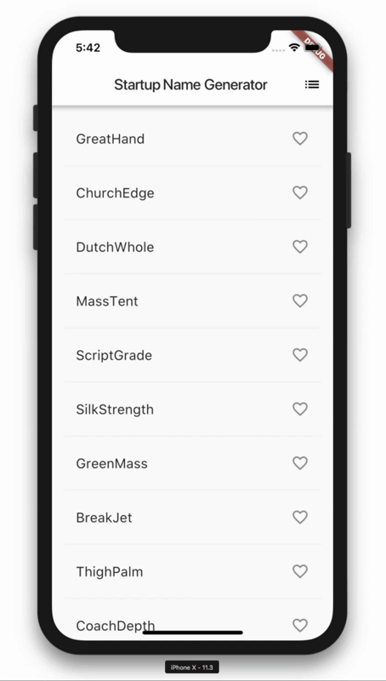
What you'll build in part 2
You'll start with a simple mobile app that generates an endless list of proposed names for a startup company.
By the end of this codelab, the user can select and unselect names, saving the best ones.
Tapping the list icon in the upper right of the app bar navigates to a new page (called a route) that lists only the favorited names.

Slide 57
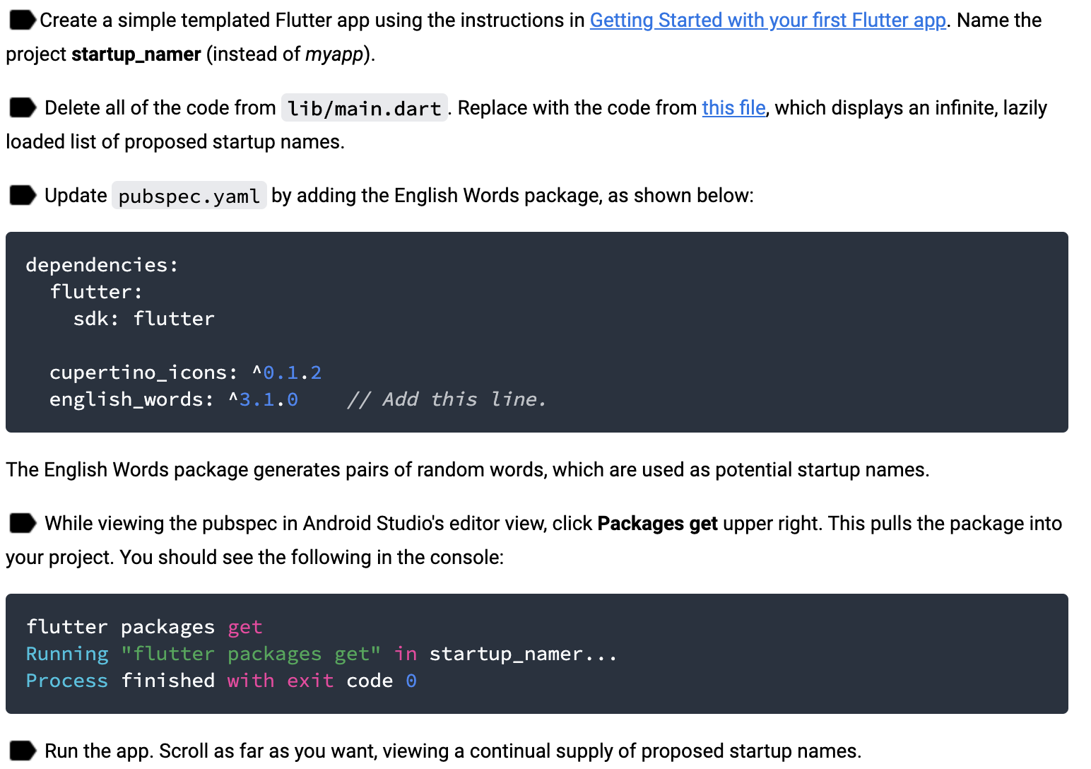
Get the Starting App
If you have worked through part 1 of this codelab, you already have the starting app, startup_namer.
See: https://codelabs.developers.google.com/codelabs/first-flutter-app-pt2/#2

Slide 58
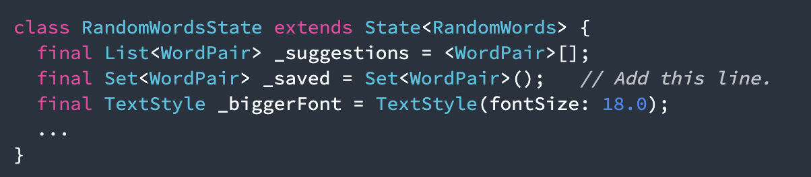
Add icons to the list
In this step, you'll add heart icons to each row. In the next step, you'll make them tappable and save the favorites.
Add a _saved Set to RandomWordsState. This Set stores the word pairings that the user favorited. Set is preferred to List because a properly implemented Set does not allow duplicate entries.

Slide 59
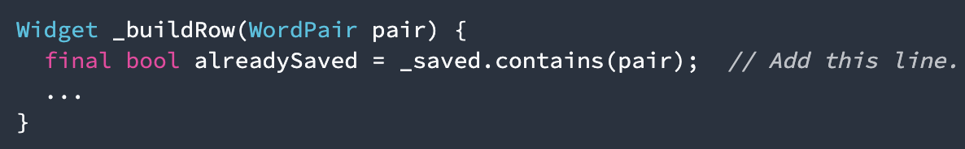
In the _buildRow function, add an alreadySaved check to ensure that a word pairing has not already been added to favorites.

Slide 60
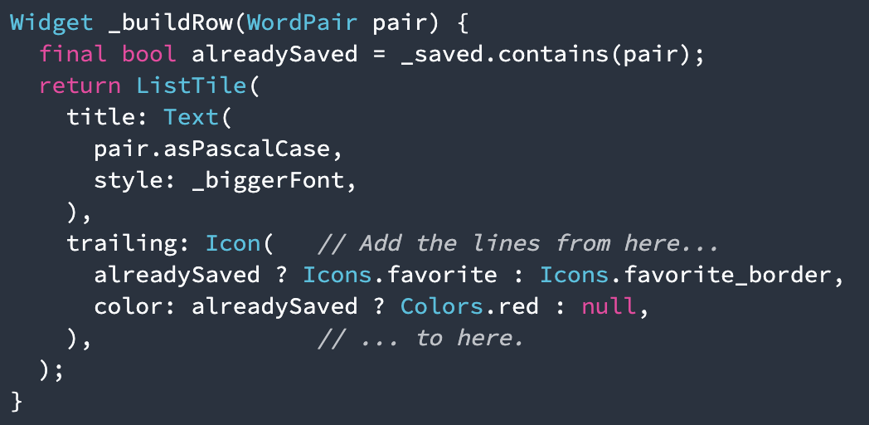
Add the icons, as shown below:

Slide 61
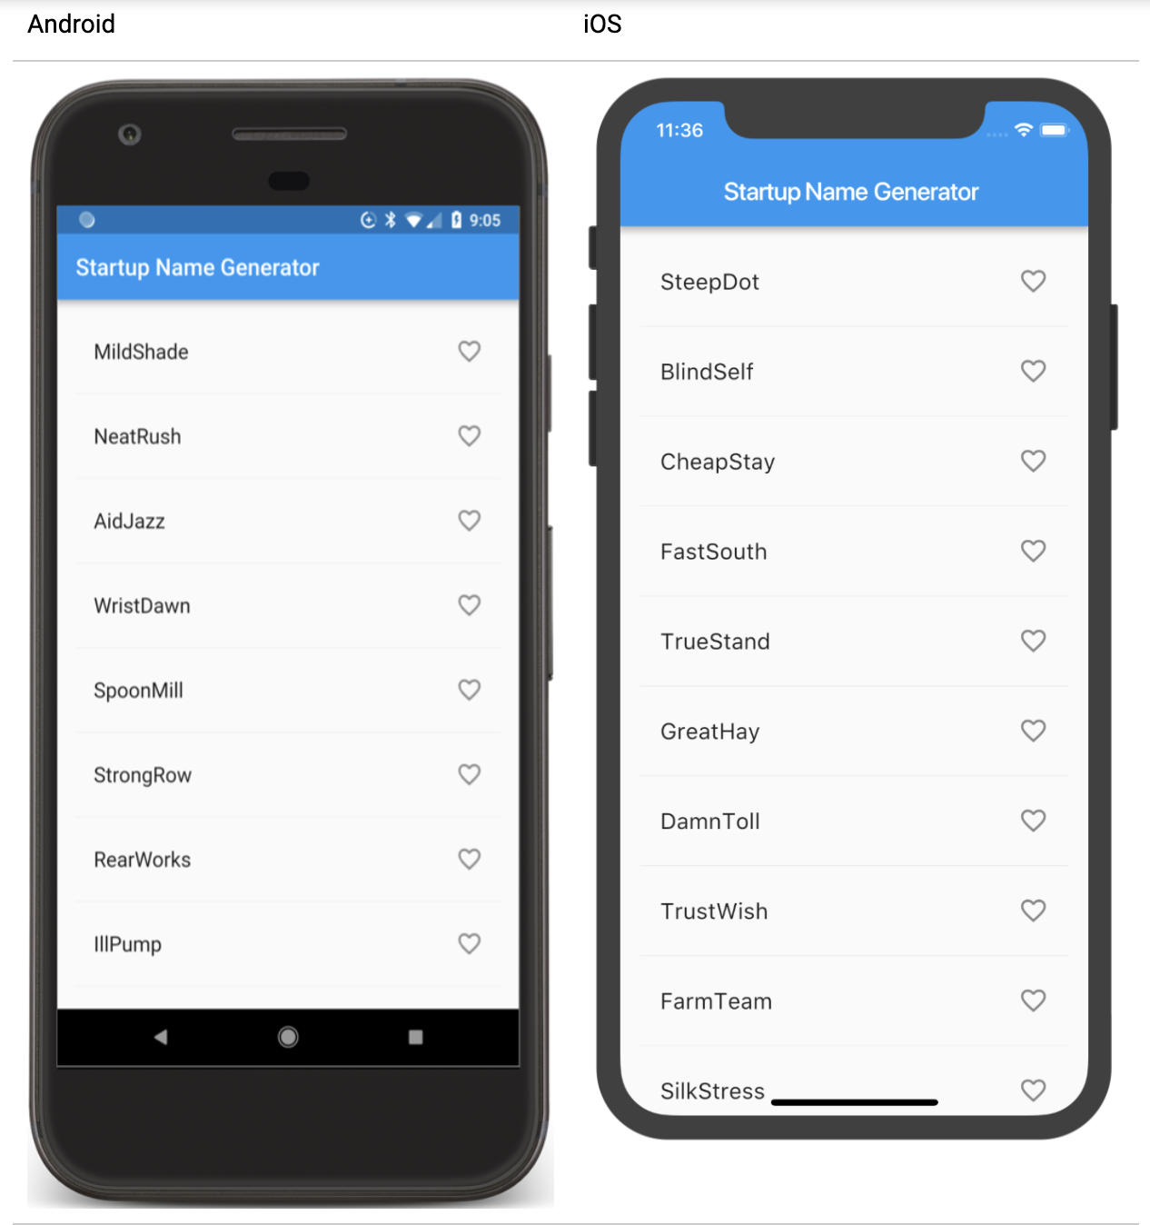
Hot reload the app. You should now see open hearts on each row, but they are not yet interactive.
Problems? If your app is not running correctly, you can use the code at the following link to get back on track.
lib/main.dart

Slide 62
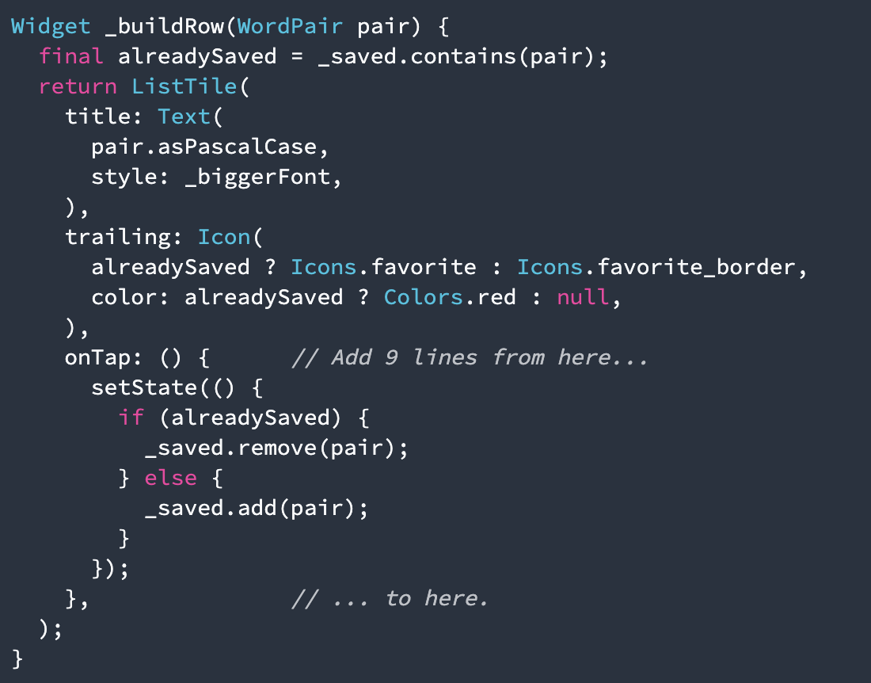
Add interactivity
In this step, you'll make the heart icons tappable. When the user taps an entry in the list, toggling its "favorited" state, that word pairing is added or removed from a set of saved favorites.
Add onTap, as shown below:

Slide 63
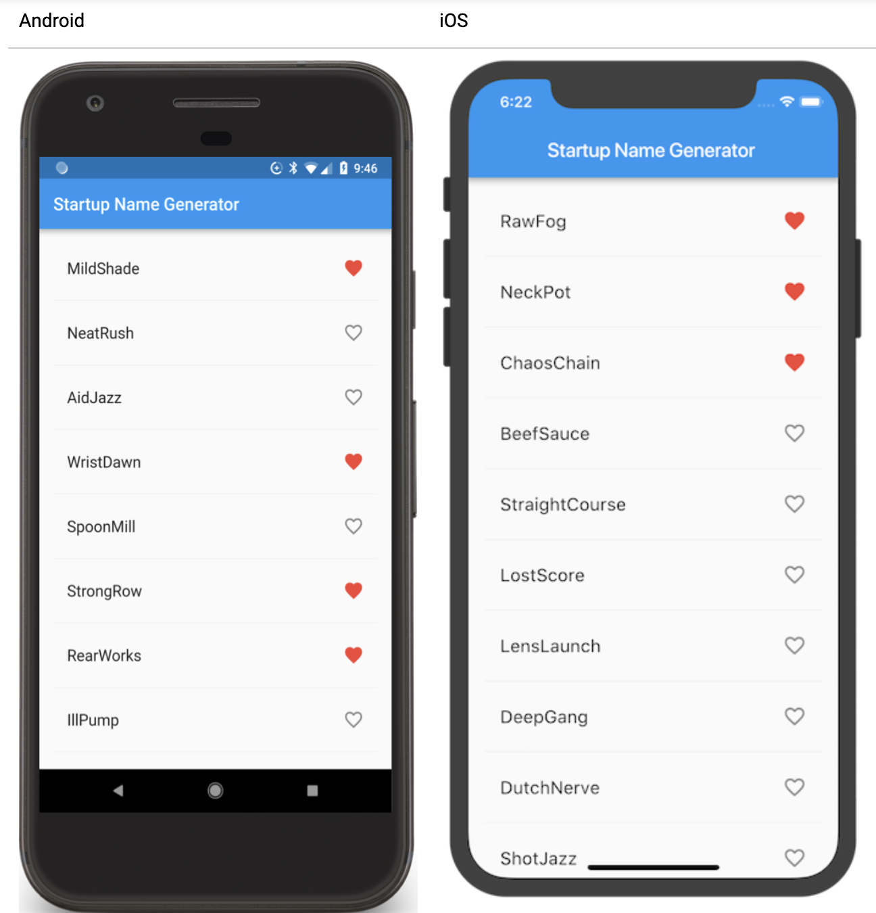
Hot reload the app. You should be able to tap any tile to favorite, or unfavorite, the entry.
Problems? If your app is not running correctly, you can use the code at the following link to get back on track.
lib/main.dart

Slide 64
Navigate to a new screen
In this step, you'll add a new page (called a route in Flutter) that displays the favorites. You'll learn how to navigate between the home route and the new route.
In Flutter, the Navigator manages a stack containing the app's routes. Pushing a route onto the Navigator's stack, updates the display to that route. Popping a route from the Navigator's stack, returns the display to the previous route.

Slide 65
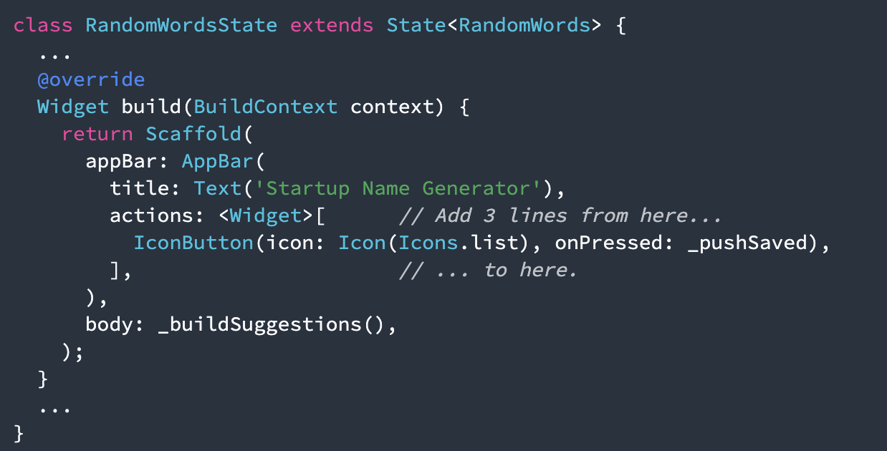
Add the icon and its corresponding action to the build method:

Slide 66
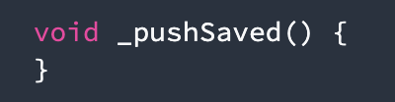
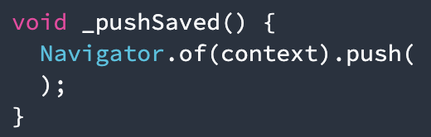
Add a _pushSaved() function to the RandomWordsState class.
Call Navigator.push, as shown below, which pushes the route to the Navigator's stack. The IDE will complain about invalid code, but you will fix that in the next section.

Slide 67
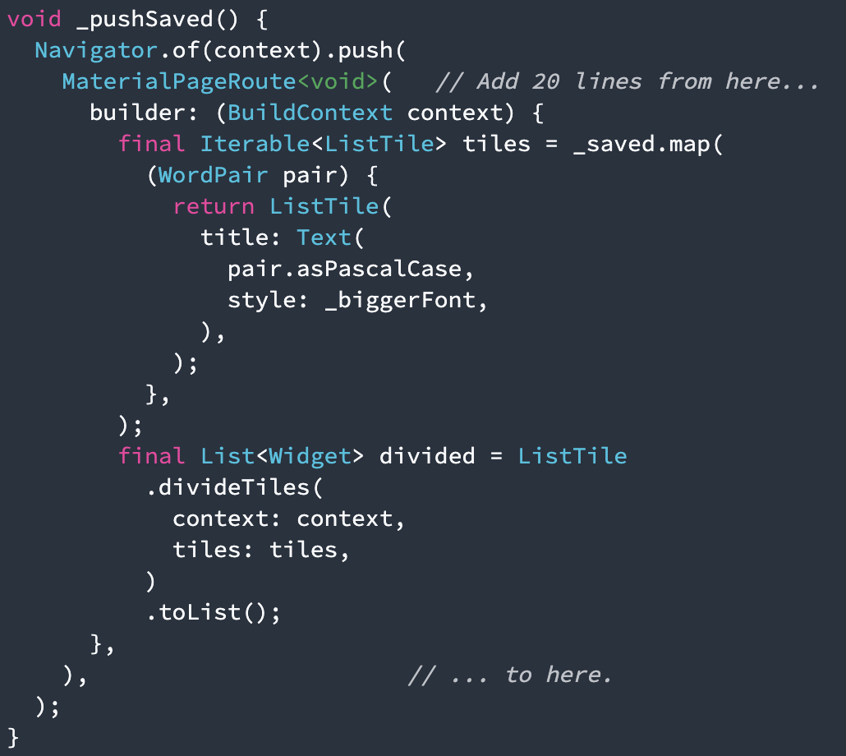
Add the code, as shown below:
The builder property returns a Scaffold, containing the app bar for the new route, named "Saved Suggestions."

Slide 68
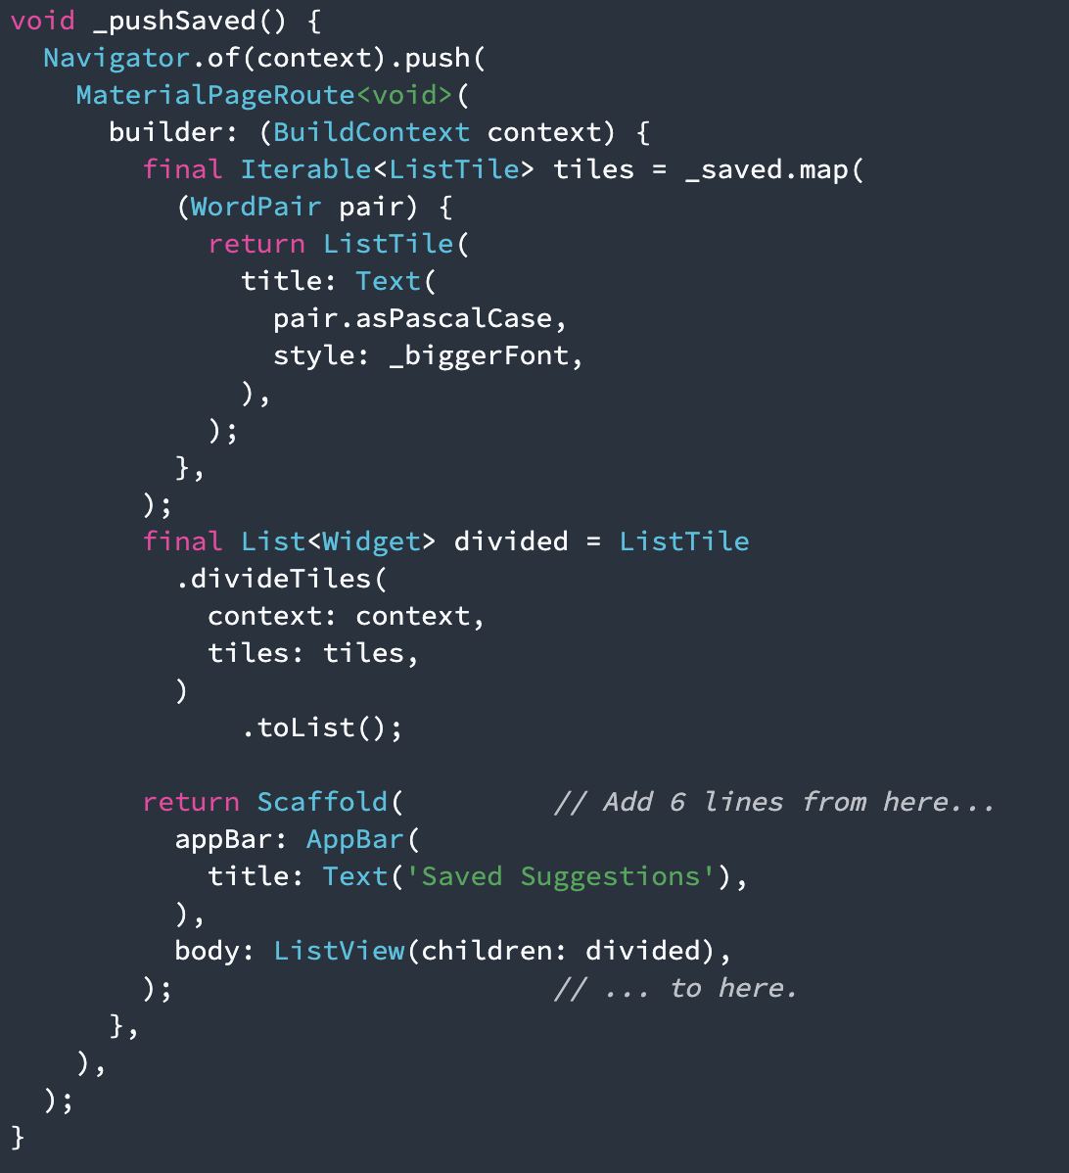
Add horizontal dividers, as shown below:

Slide 69
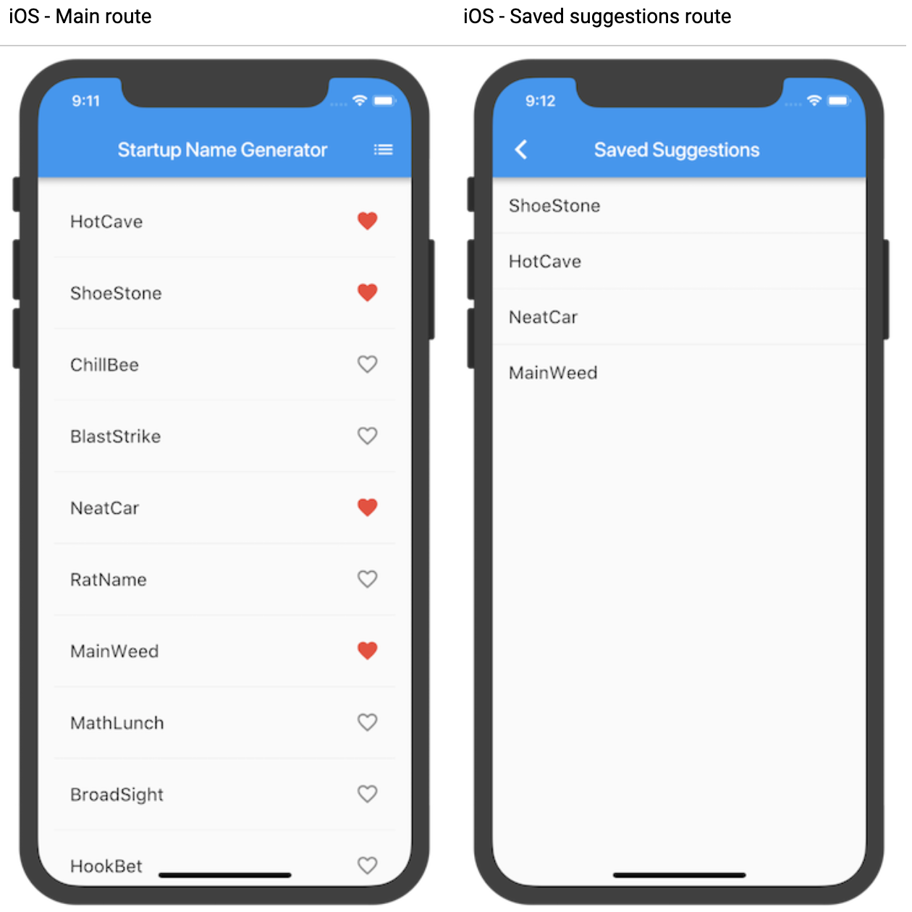
Hot reload the app.
Problems? If your app is not running correctly, you can use the code at the following link to get back on track.
lib/main.dart

Slide 70
Change the UI using Themes
In this step, you'll modify the app's theme.
The theme controls the look and feel of your app.
You can either use the default theme, which is dependent on the physical device or emulator, or customize the theme to reflect your branding.

Slide 71
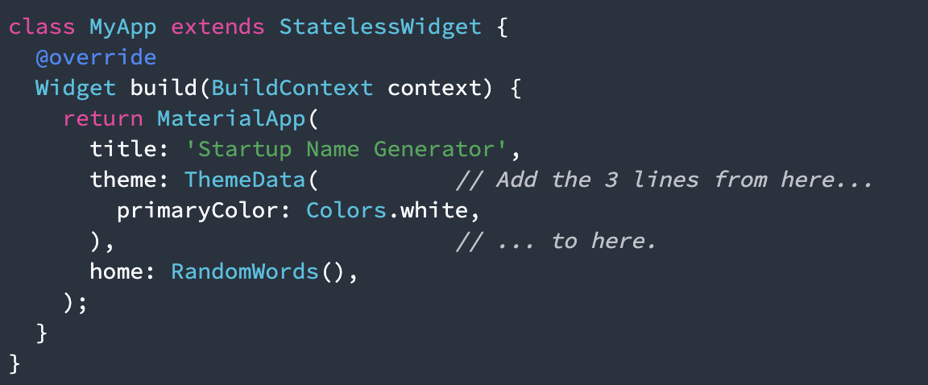
Change the color in the MyApp class:

Slide 72
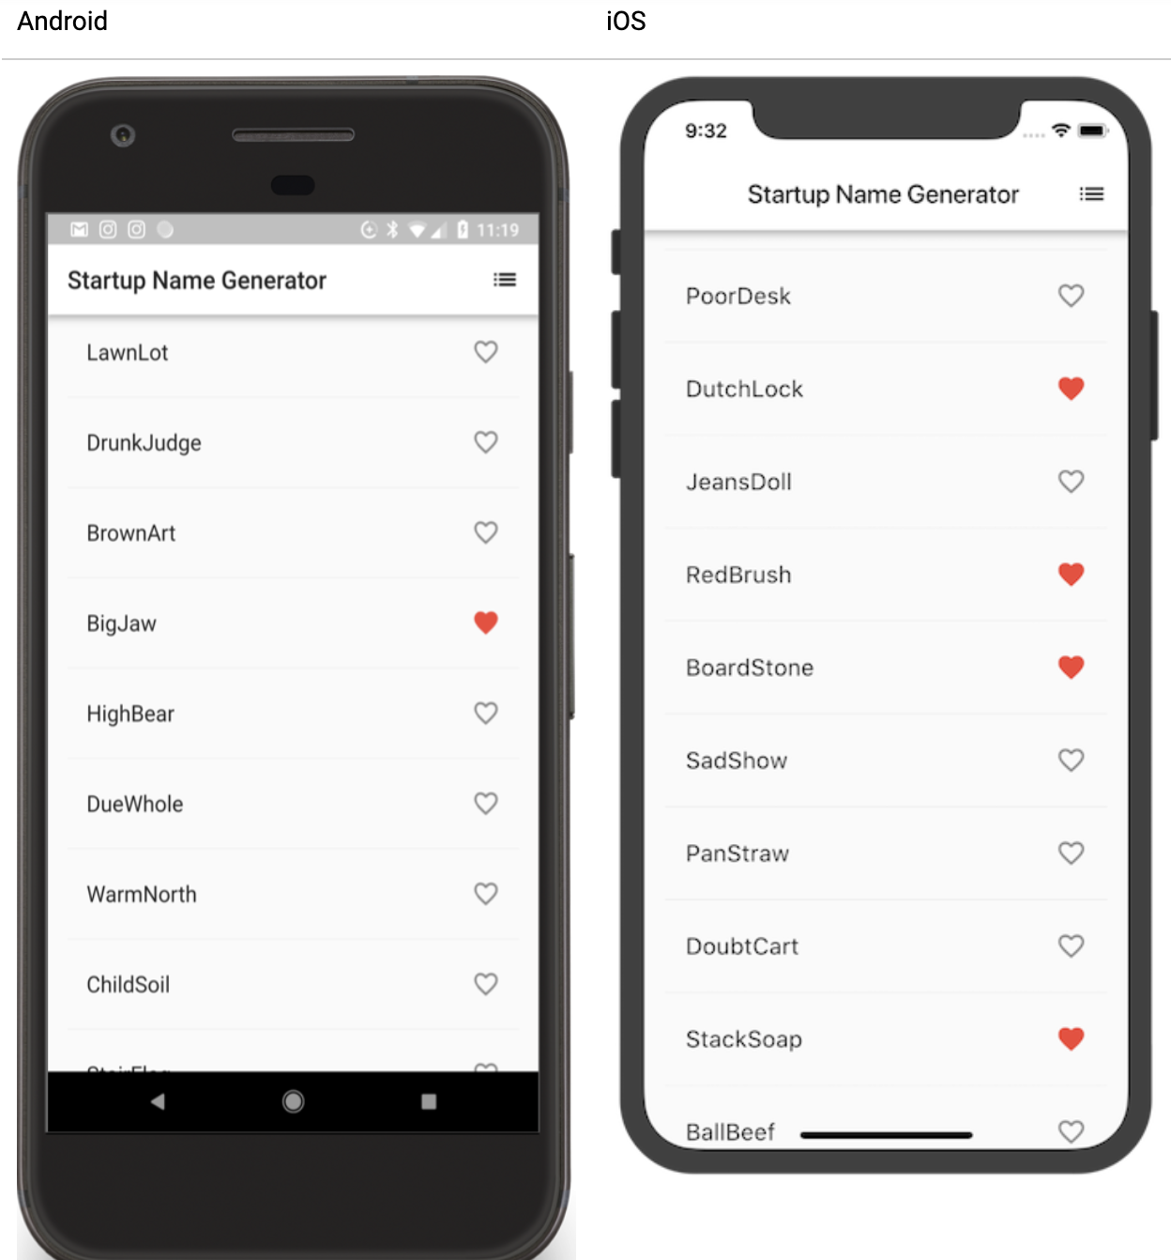
Hot reload the app. The entire background is now white, even the app bar.
Problems? If you've gotten off track, use the code from the following link to see the code for the final app.
lib/main.dart

Slide 73
Well done!
You've written an interactive Flutter app that runs on both iOS and Android. In this codelab, you've:
Written Dart code.
Used hot reload for a faster development cycle.
Implemented a stateful widget, adding interactivity to your app.
Created a route and added logic for moving between the home route and the new route.
Learned about changing the look of your app's UI using themes.

Slide 74
Next steps
Learn more about the Flutter SDK:
Building layouts in Flutter tutorial
Add interactivity tutorial
Introduction to widgets
Flutter for Android developers
Flutter for React Native developers
Flutter for web developers
Flutter's Youtube channel

Slide 75
Other resources include:
Build Native Mobile Apps with Flutter (a free Udacity course)
Flutter cookbook
From Java to Dart codelab
Bootstrap into Dart: learn more about the language

Slide 76
Thank you!
Wenxuan Shi
College of Software, Nankai University
Email: shiwx@nankai.edu.cn
Wechat: 13920561100

